Slide 1

WOOD + VlNYL FLOORING

Slide 2
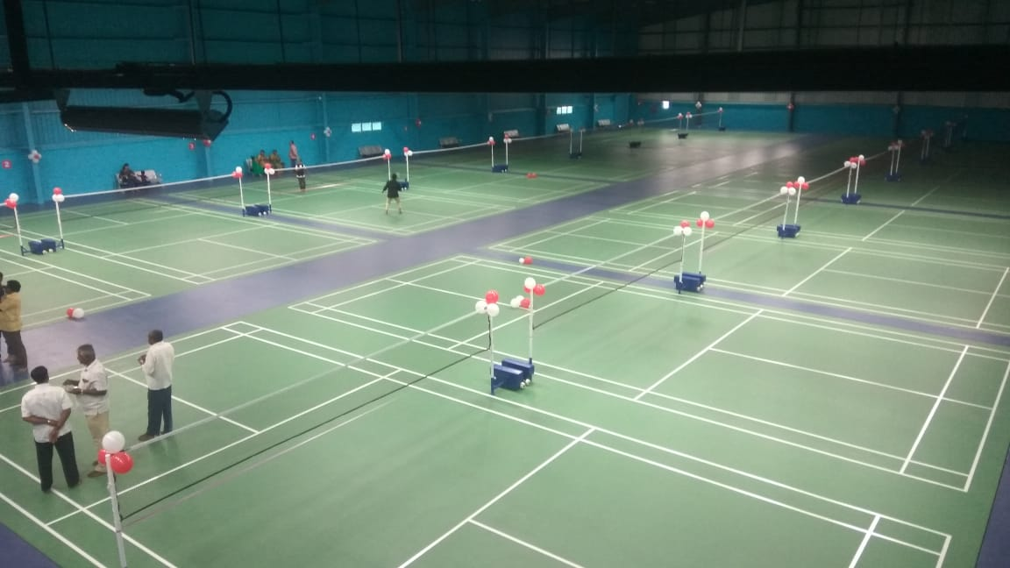
MAKING SPORTS ACCESSIBLE TO ALL

Slide 3
CONTENTS
Product specifications
Materials for installation
Pre installation check
Installation procedure
Line marking
Do’s & don’ts
Maintenance care manual

Slide 4
1. Product specifications
The entire system thickness is 80mm.
It consists of 10mm rubber pads, 45mm thick runners, 19mm thick calibrated ply wood, 6.7mm thick vinyl
The size of the ply board will be 8ft*4ft
6.7mm graboplast vinyl is installed above the ply board.

Slide 5
2. Materials for installation
Moisture barrier of 200micron
10mm rubber pads
Runners of 75mm width and 45mm thick of varying length.
8ft*4ft of 19mm thick calibrated plywood.
2 inches POP screws
Acrylic putty
6.7mm vinyl

Slide 6
3. Pre installation check
Moisture content should be less than 2.5%
Anti termite treatment should be done at the corners and on top of the sub base.
Undulations on the sub base should not be more than 5mm for ever 3m*3m area.
Platform height should be not more than 82mm.
Edges should be straight.
All the other works in the court should be completed before the installation starts.

Slide 7
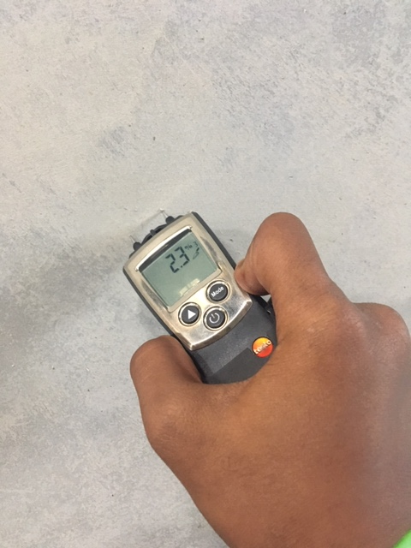
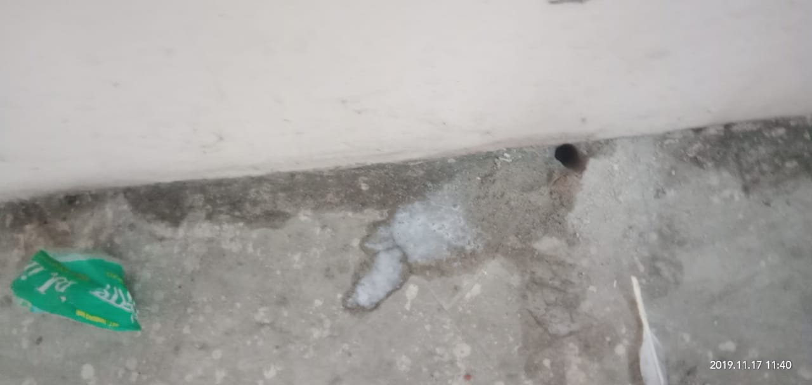
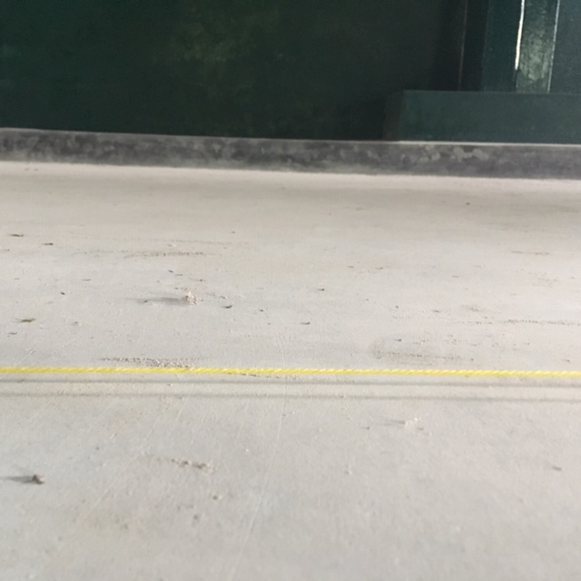
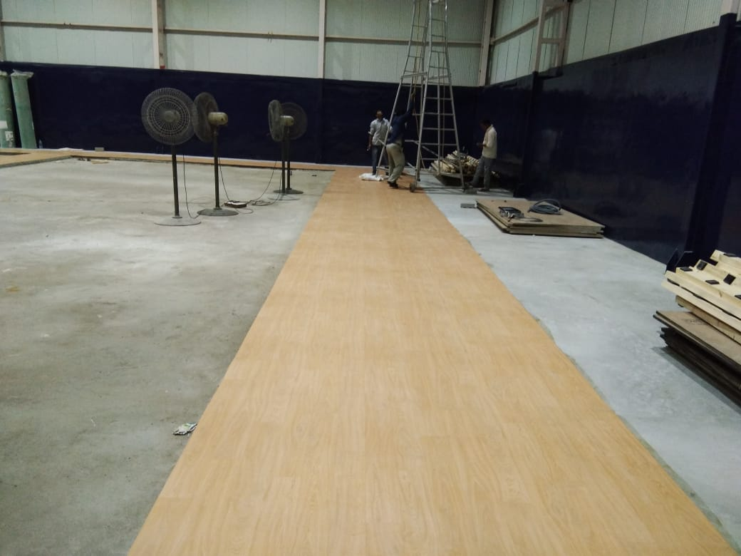
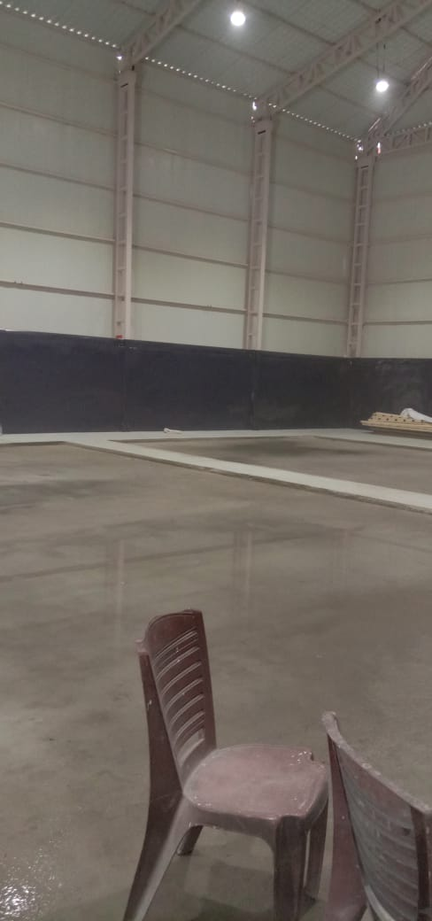

Slide 8
4.Installation procedure
Shock pads fixing
Moisture barrier laying
Runner placement
Ply board fixing
Screwing
Grinding
Joints filling with acrylic putty
Sanding
Cleaning
Vinyl flooring installation

Slide 9
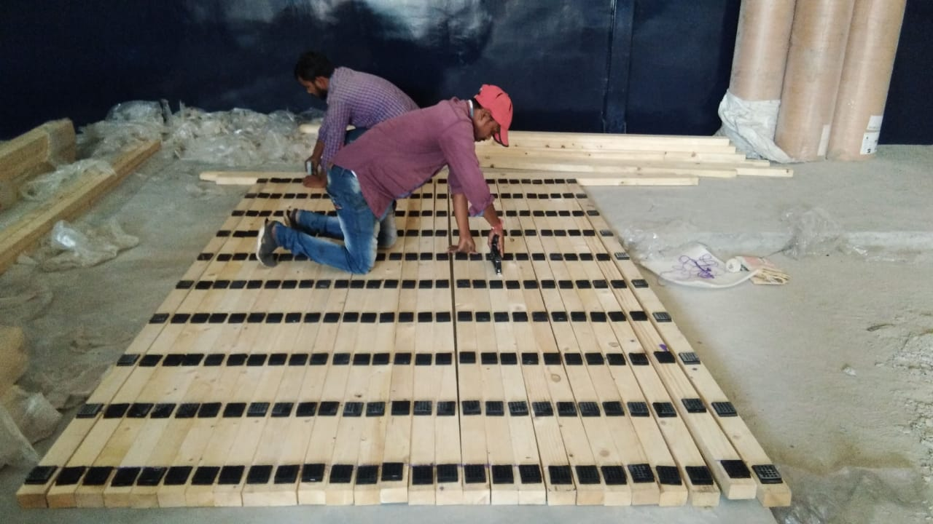
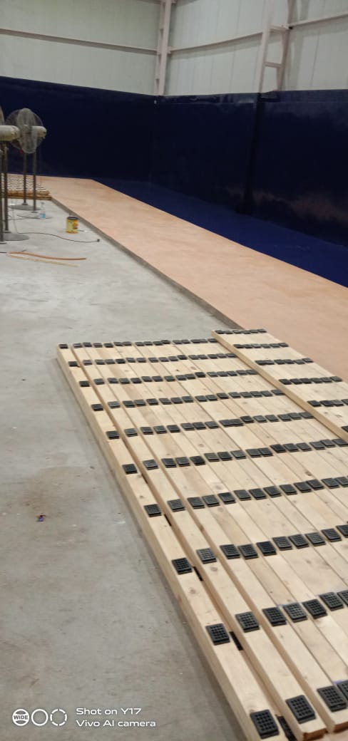
i. Shock pads fixing
Shock pads of 10mm are fixed to the runners using the stapler pins
The clear gap between 2 shock pads will be 305mm from c/c

Slide 10
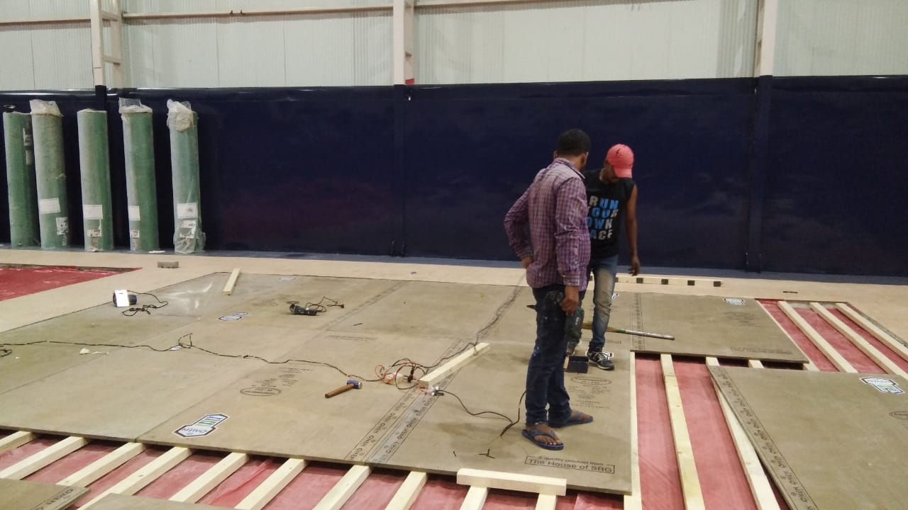
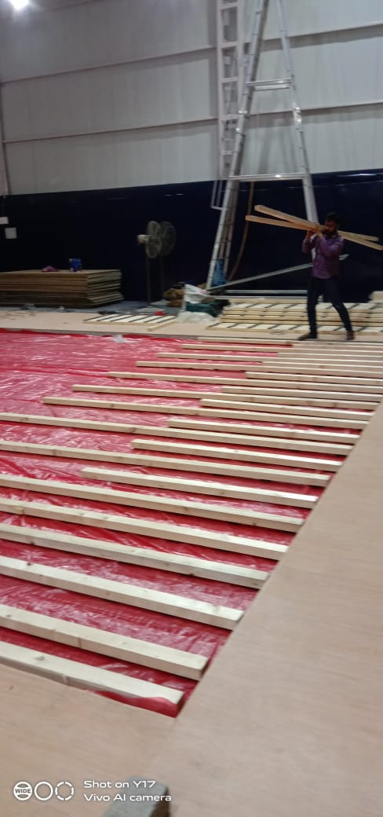
ii . Moisture barrier laying and runner placement
Moisture barrier of 200 micron is layed throughout the area along the length.
Runners are placed along the length of the court(parallel to the court)
The spacing between the runners is 305mm from c/c

Slide 11
iii. Ply board installation & Screwing
Ply board of 8ft*4ft size is placed above the runners.
The ply board is placed parallel to the runners placed.
Screwing of ply board is done using 2 inches POP screw.
In each ply board 40 screws are done to fix the ply board.
All the edges of the ply board along the length should rest on the runners only.

Slide 12
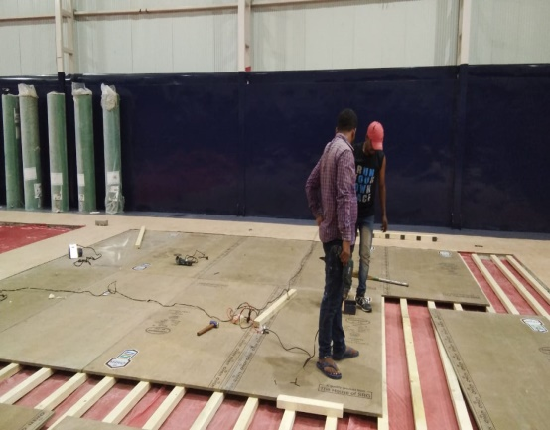
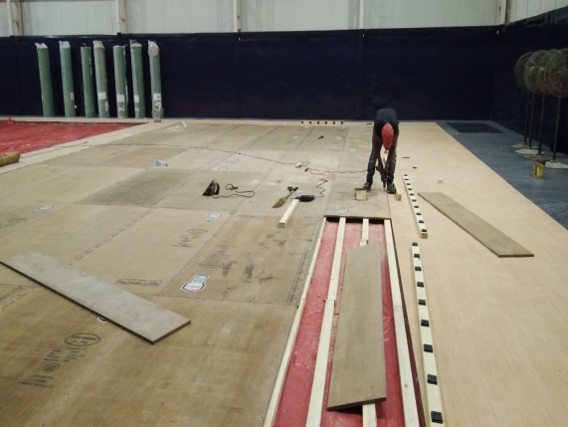
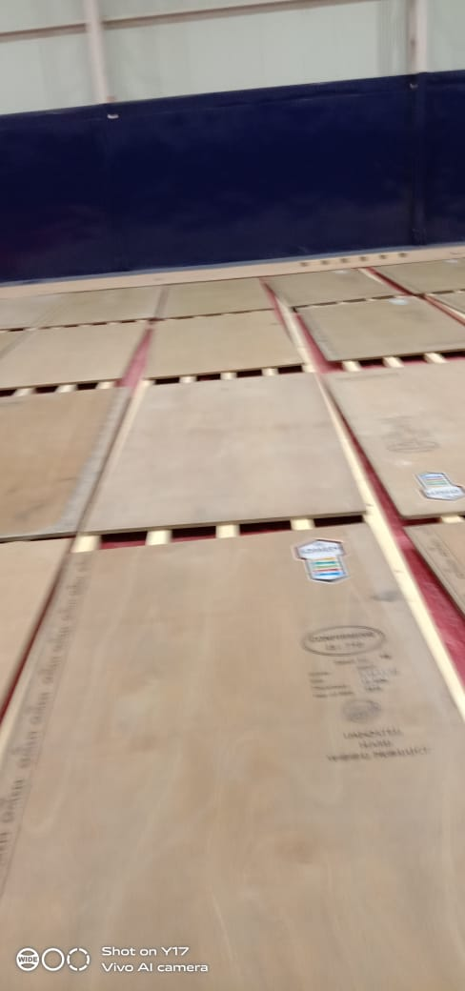
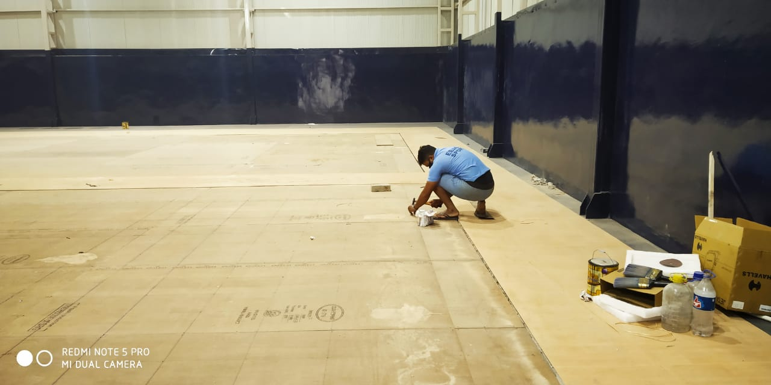
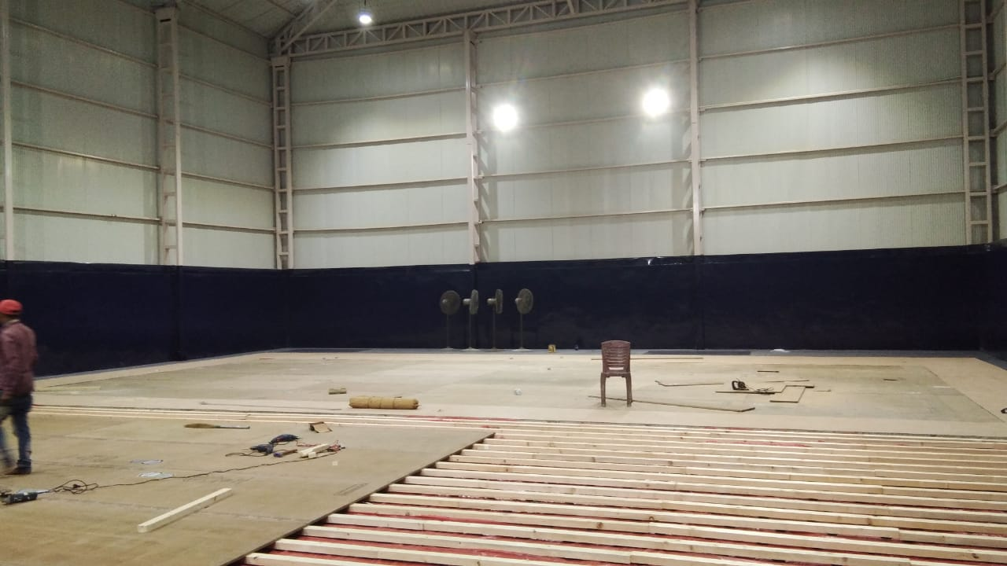
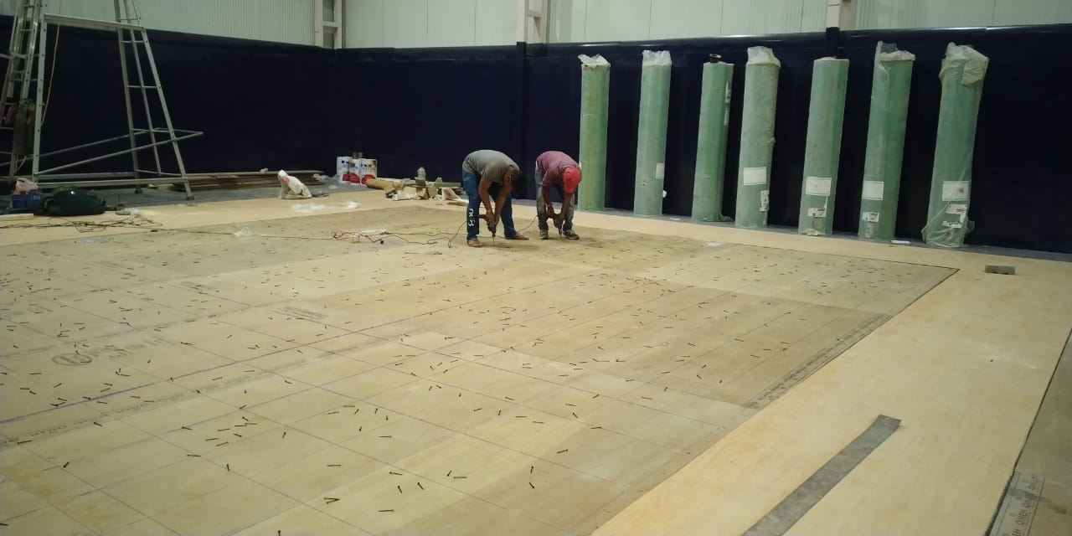

Slide 13
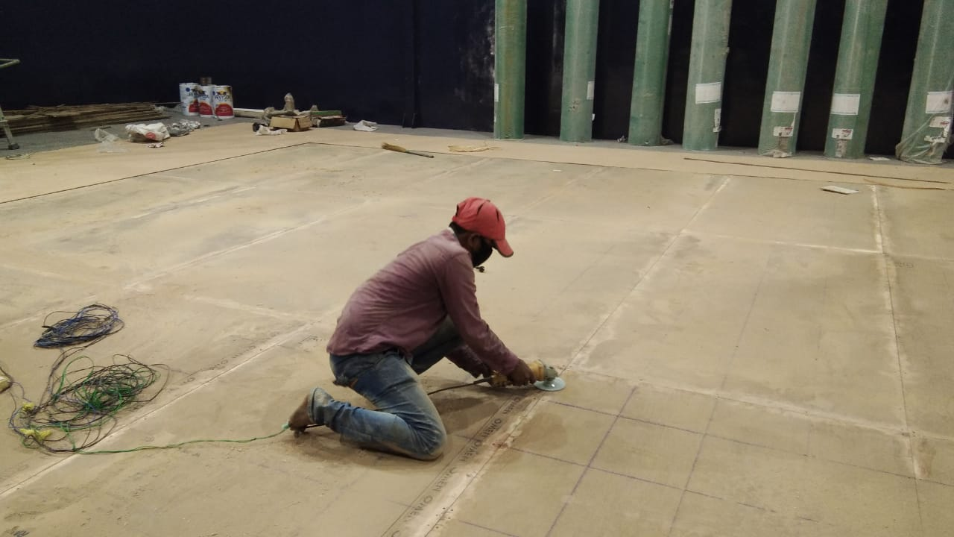
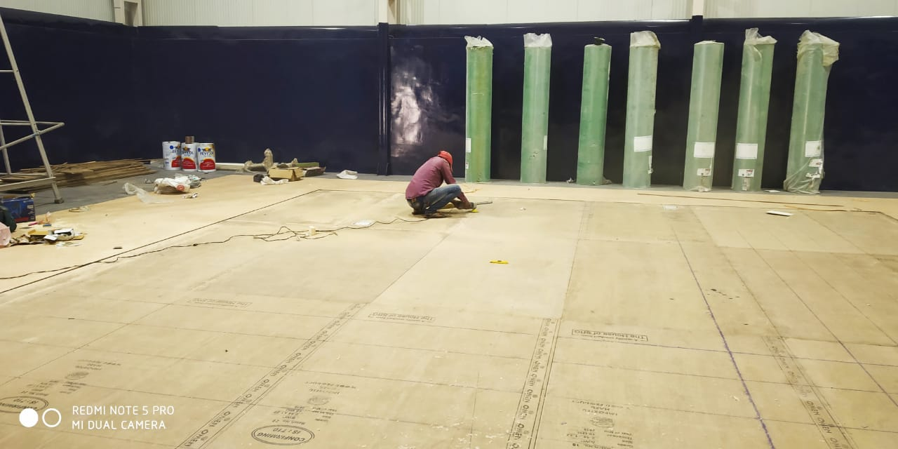
iv. Joints Grinding
All the joints are grinded so that there is no offset(obstruction) between the 2 play boards.

Slide 14
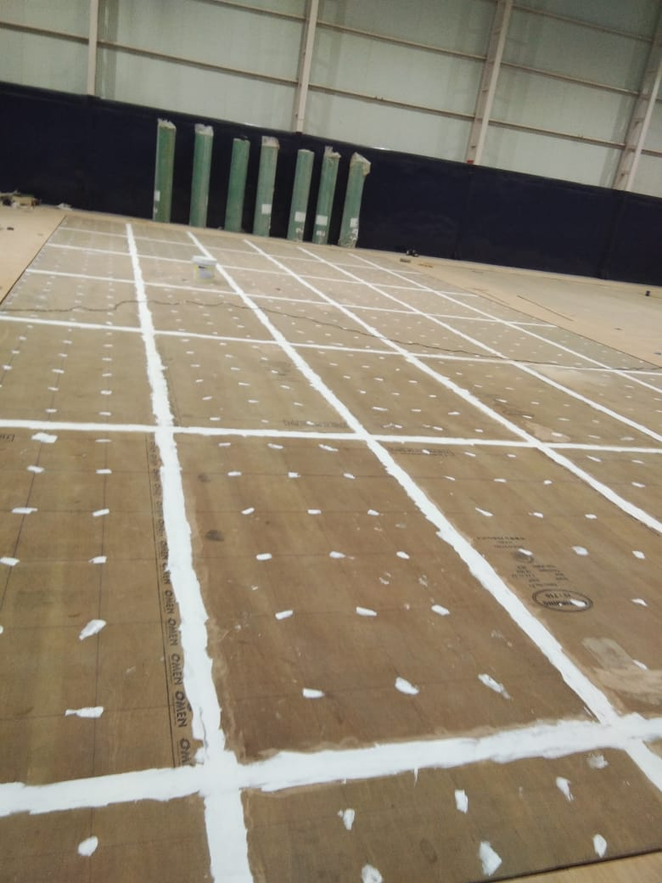
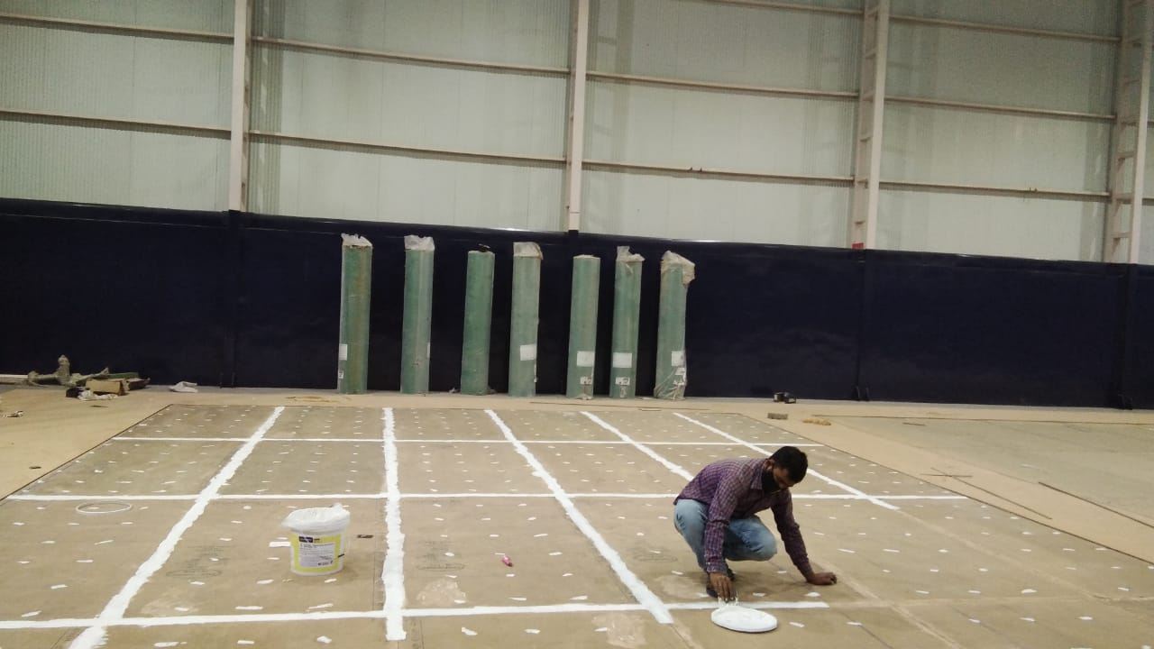
v. Joints Filling.
The joints and the gaps are filled using acrylic putty.

Slide 15
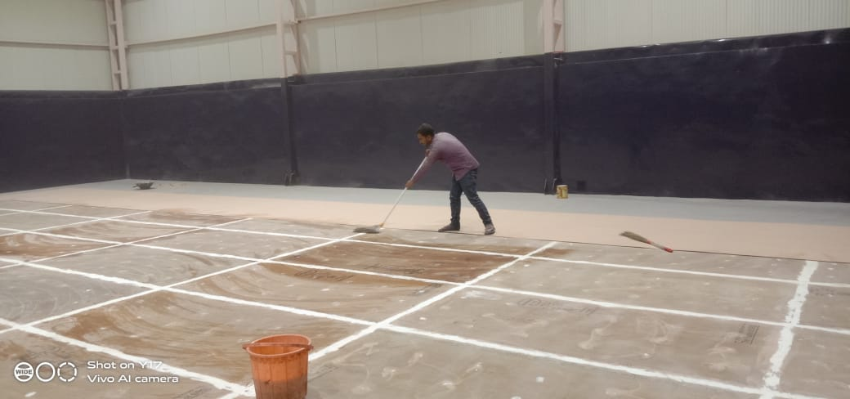
vi. Sanding and cleaning
After the gaps are filled with acrylic putty, the sanding of the joints is carried on in such a way that the gaps should not be visible.
There should not be obstruction between the joints.
Cleaning is carried on after the sanding is completed.

Slide 16
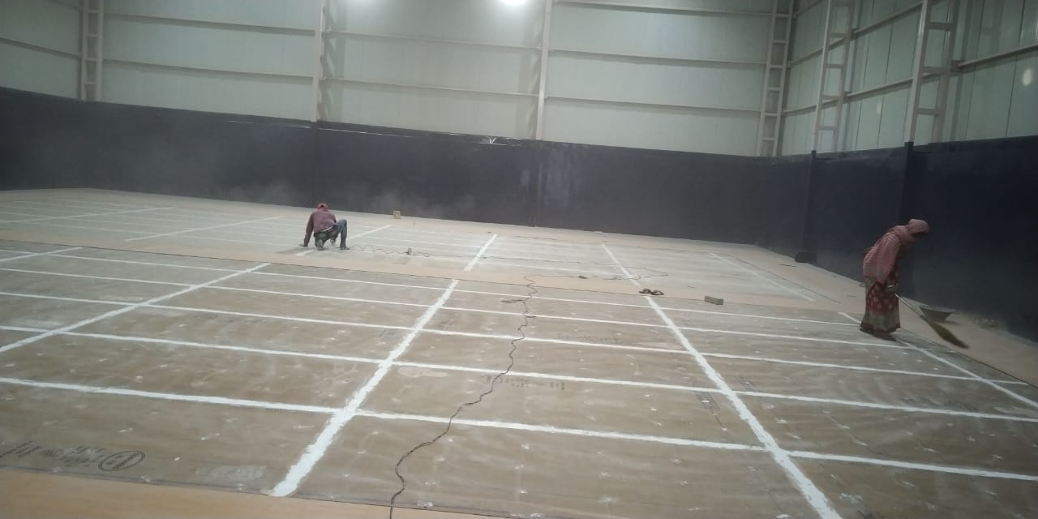
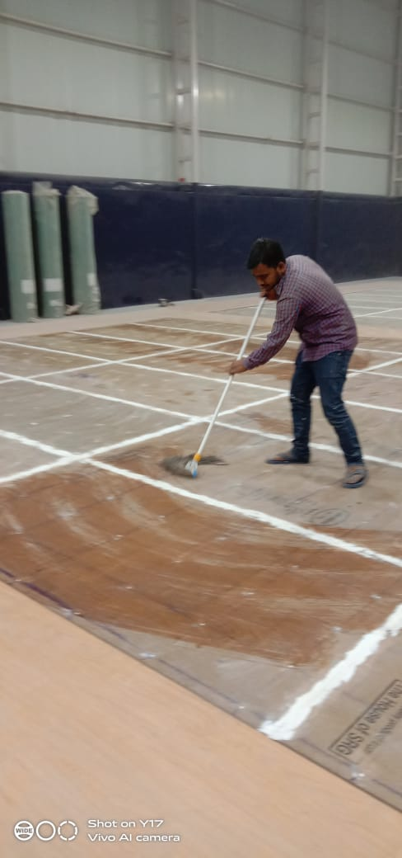
Images

Slide 17
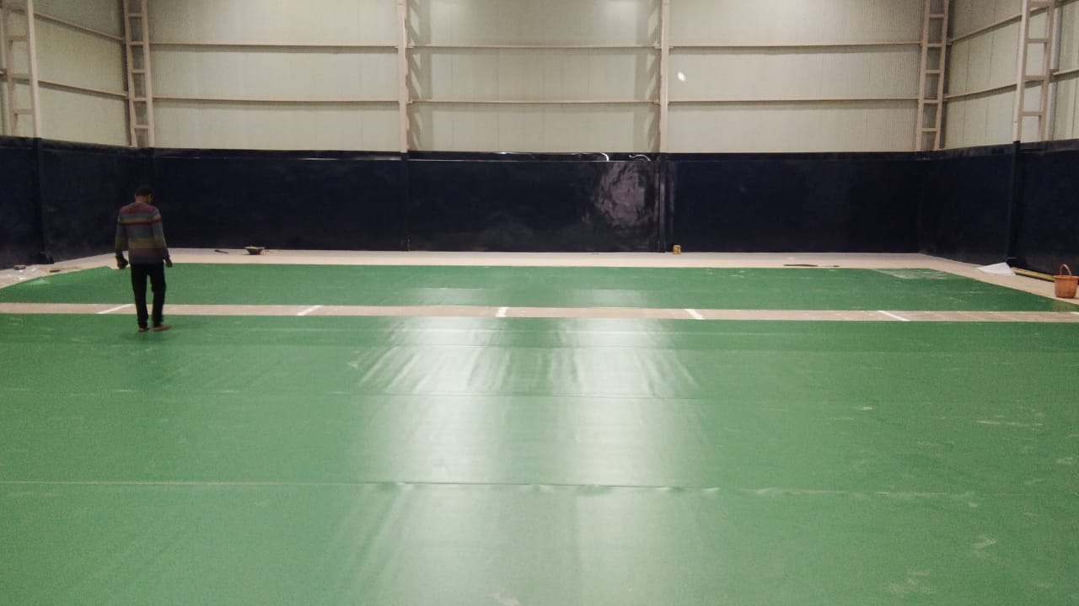
Vii . Loose laying of vinyl and pasting
Loose Laying of vinyl is done on the surface and kept it for 24 hours so that all the wrinkles are eliminated.
Pasting of the vinyl is carried out on the next day, only partial pasting of vinyl and proper cutting of edges is done
Full pasting is not recommended.

Slide 18
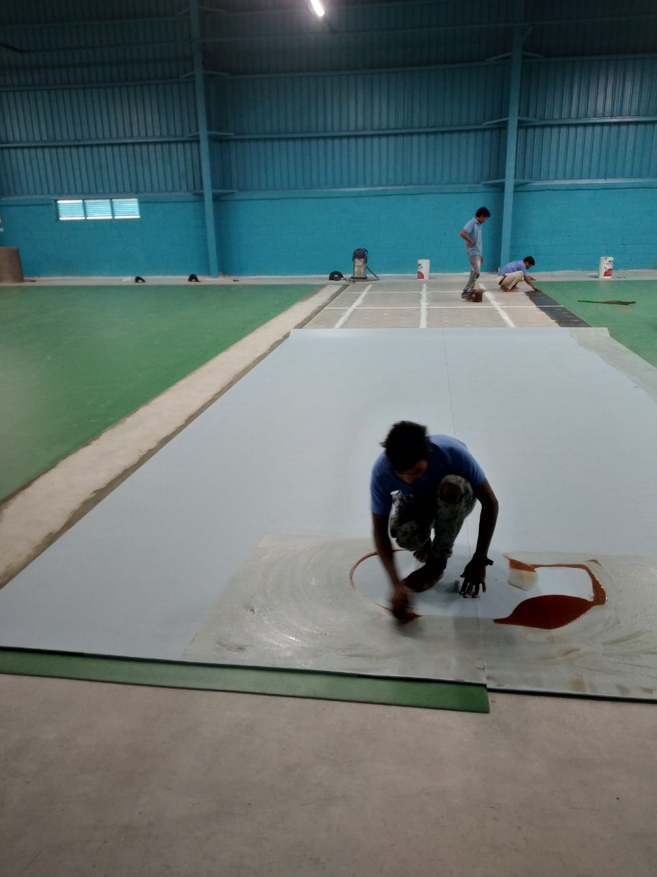
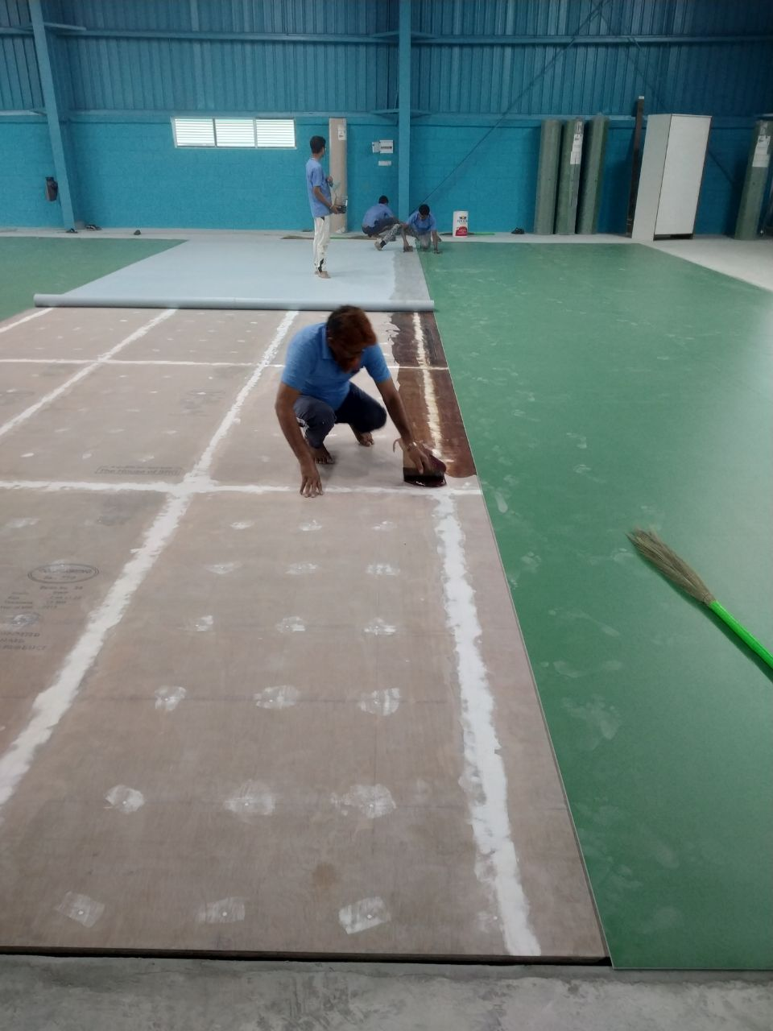
Partial Pasting images
Pasting is done at the corners of the vinyl flooring, around 500mm from the corners at all the 4 sides.

Slide 19
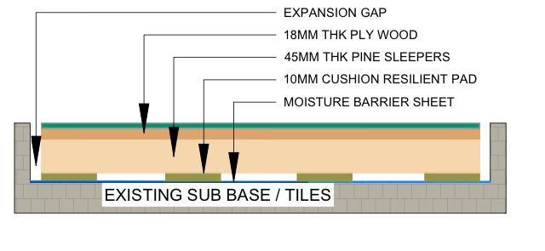
Cross section of wooden flooring

Slide 20
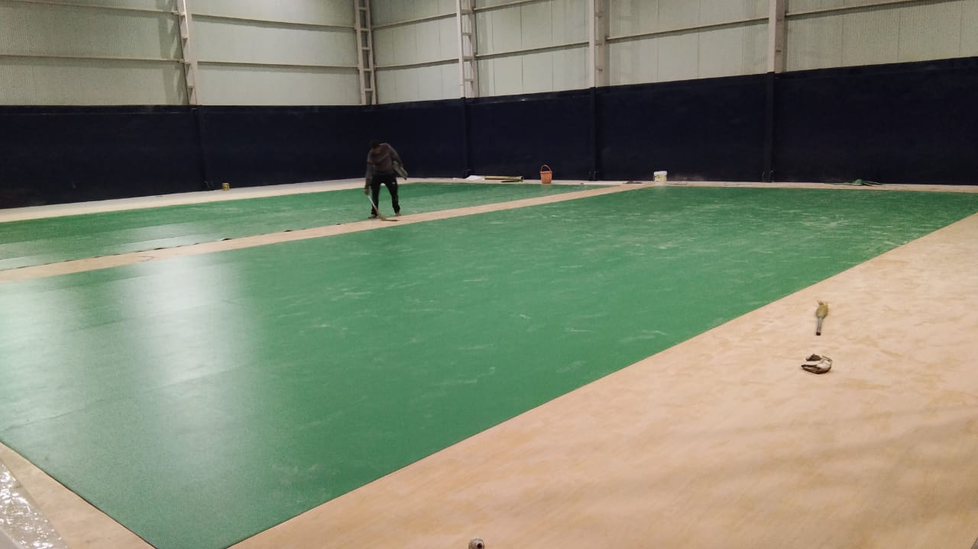
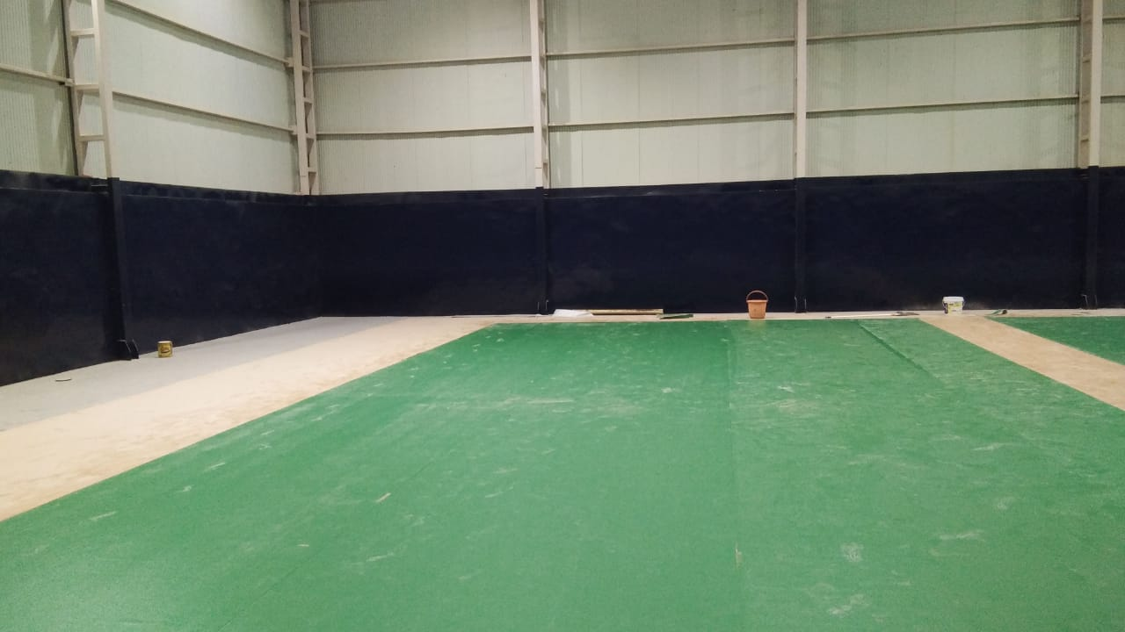
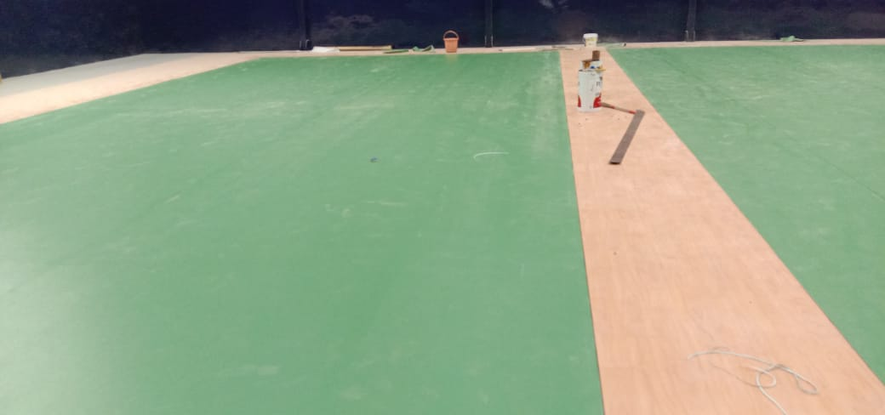
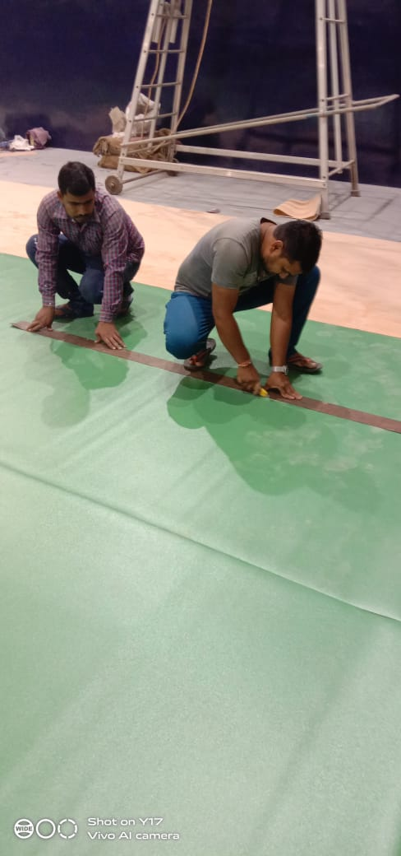
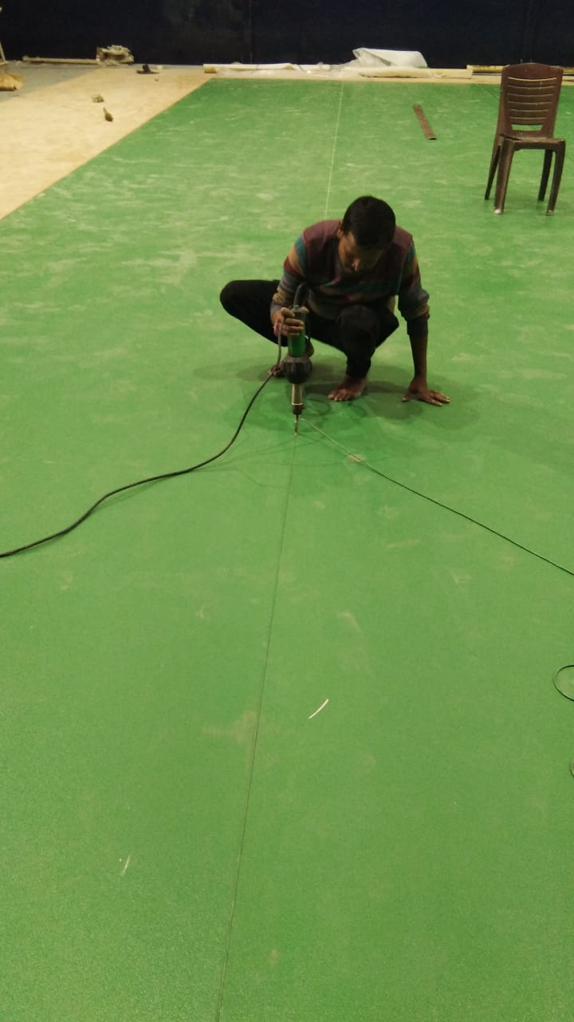
Images

Slide 21
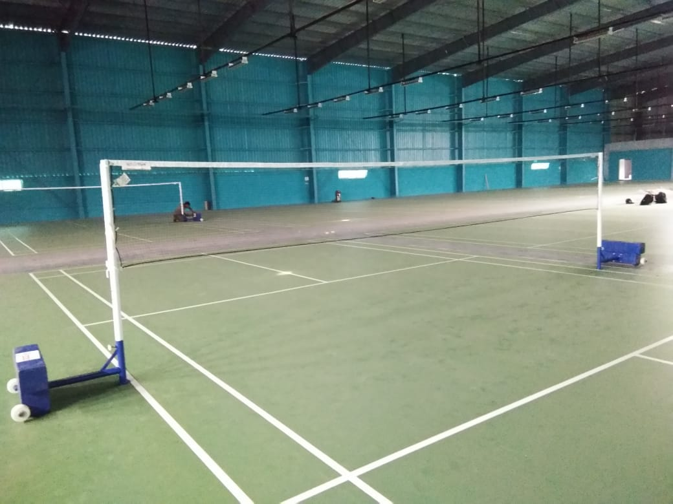
5. Game Line marking
Game line marking will be done for all the walls as per the standard court dimensions.

Slide 22
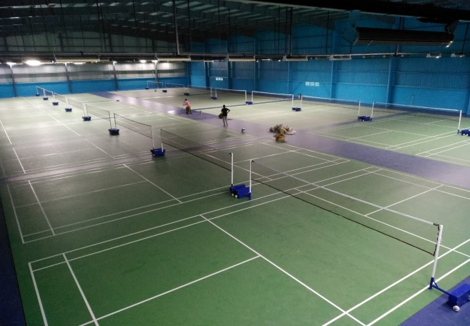
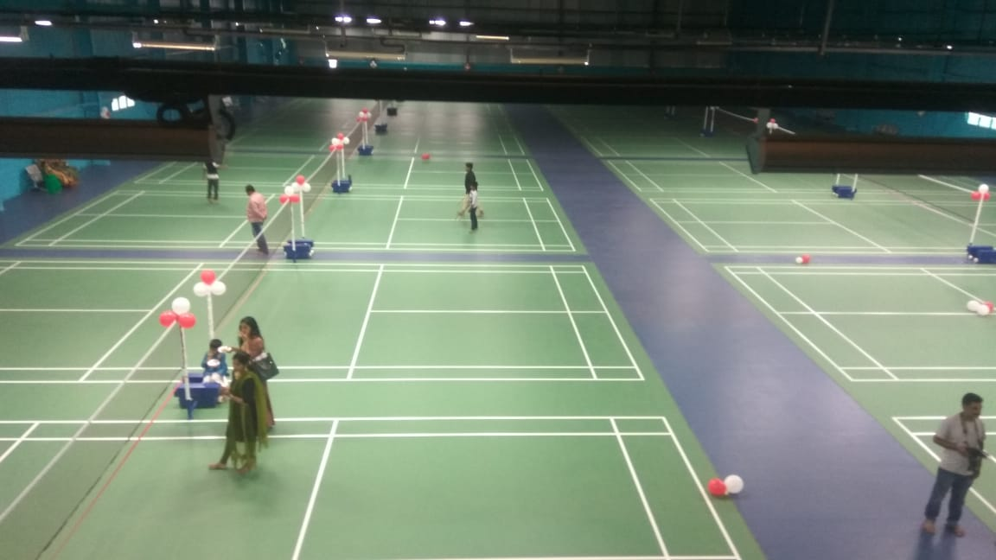
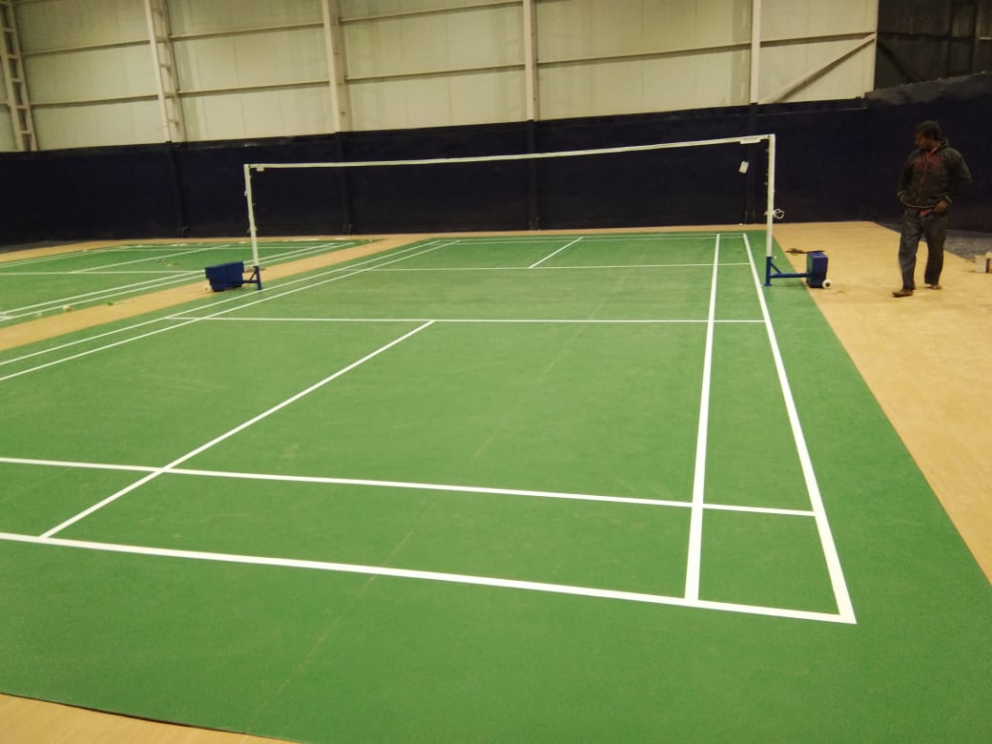
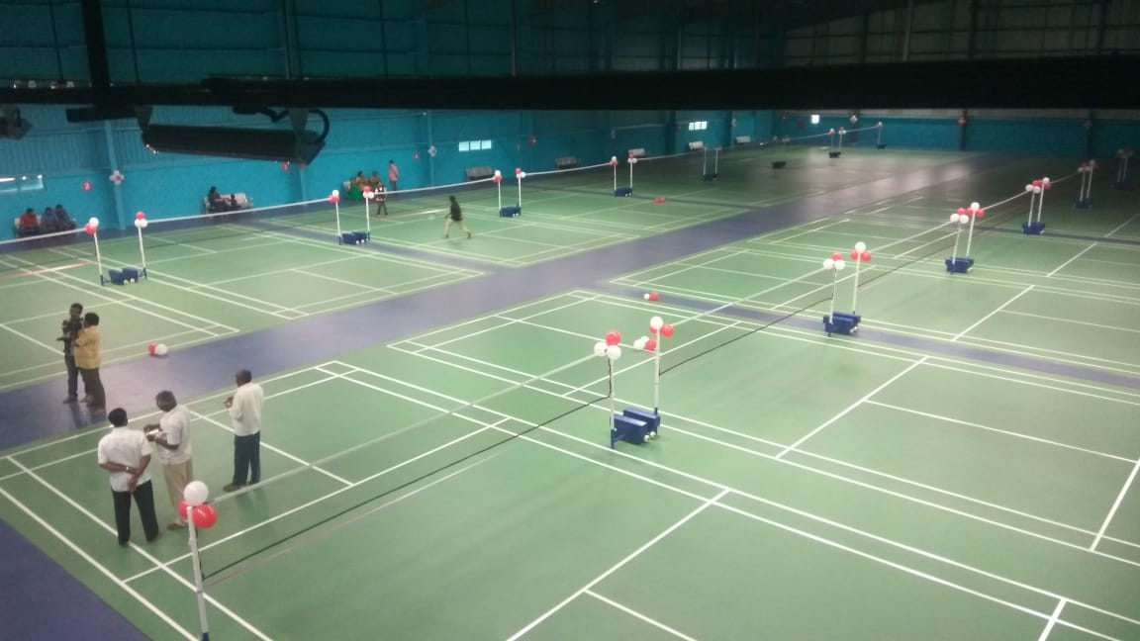
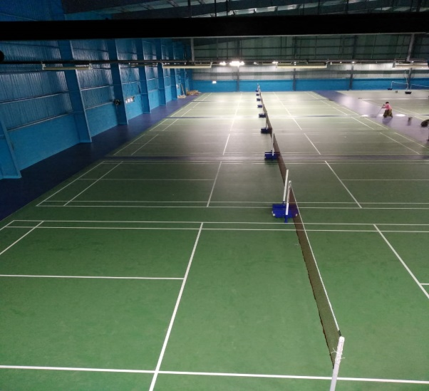
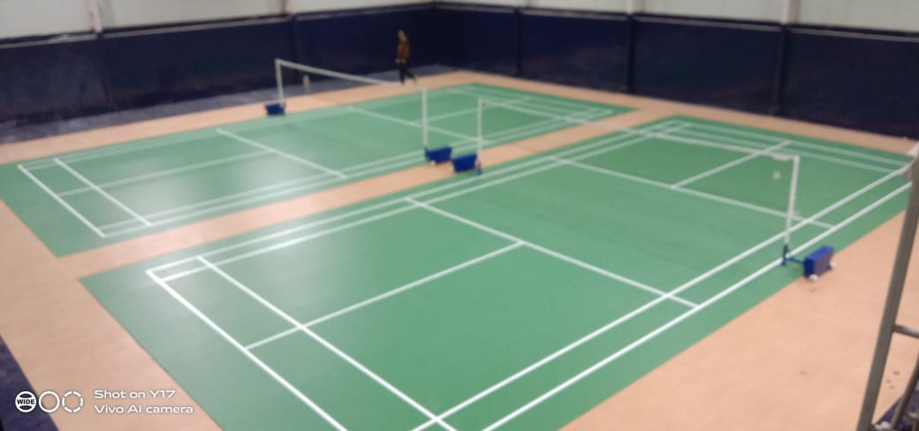
Play Nine
Play Nine
Dhanbad club
Play Nine
Play Nine
Dhanbad club

Slide 23
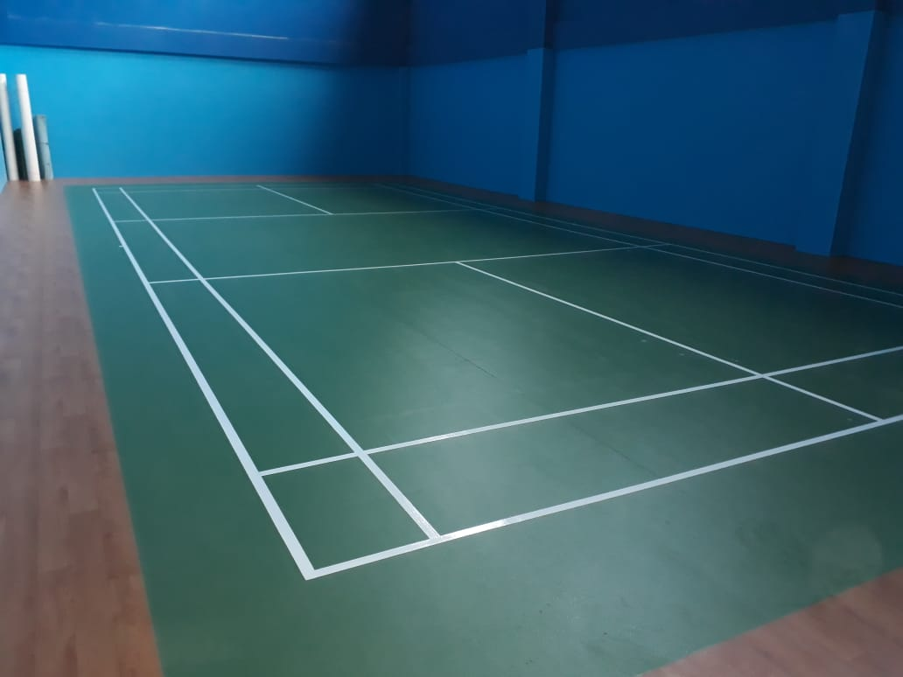
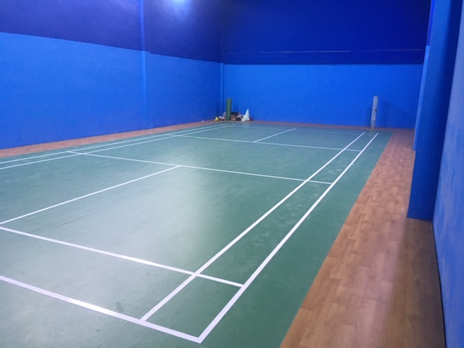
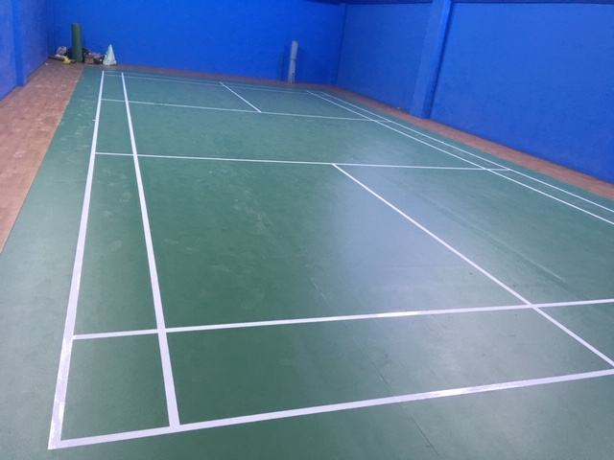
IAS ACADEMY

Slide 24
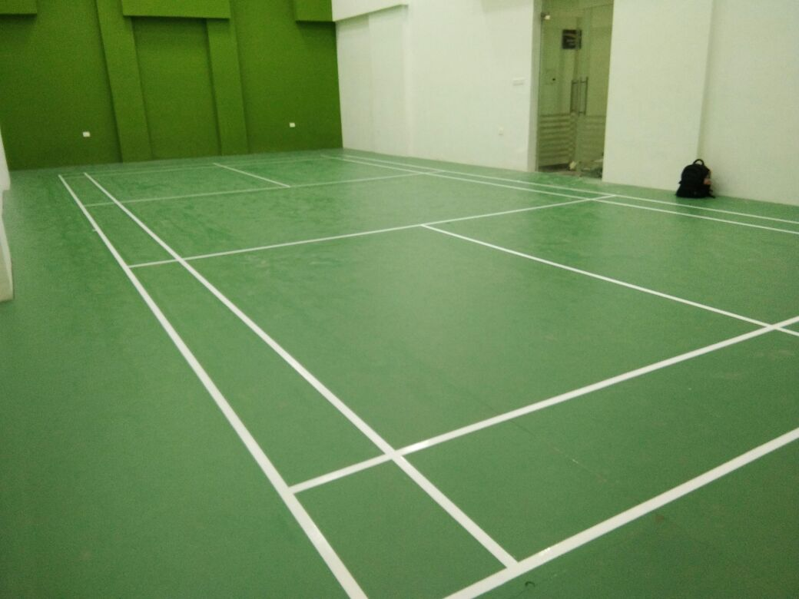
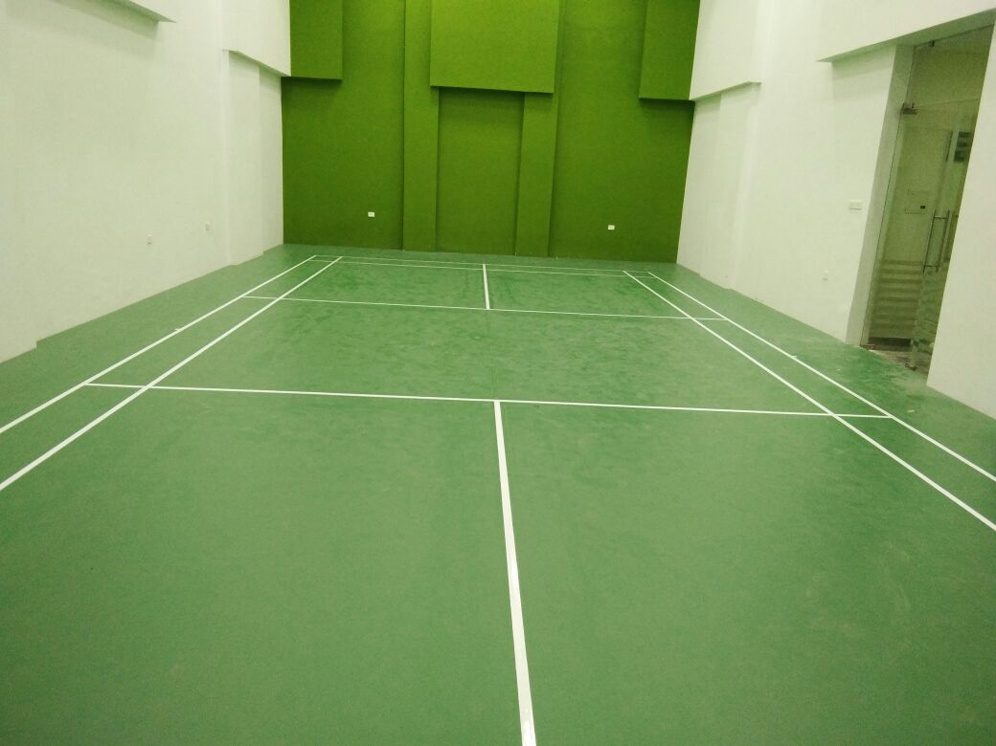
SALARPURIA LUXURIA,BANGALORE

Slide 25
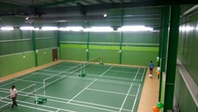
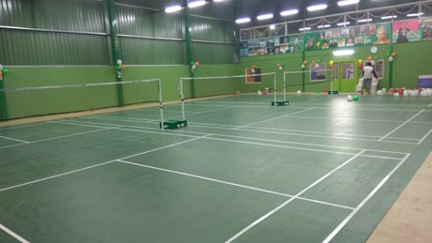
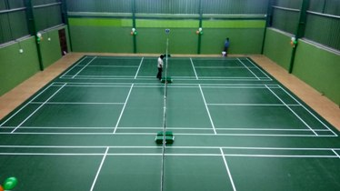
LAKE SIDE SPORTS,Bangalore

Slide 26
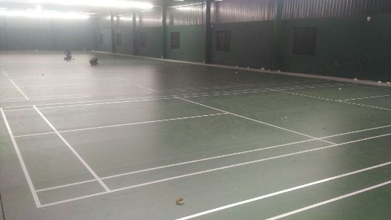
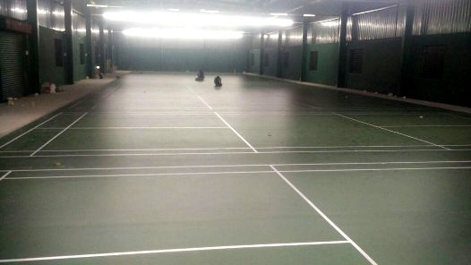
Sports Alley,Bangalore

Slide 27

6.Do’s & Don’ts

Slide 28
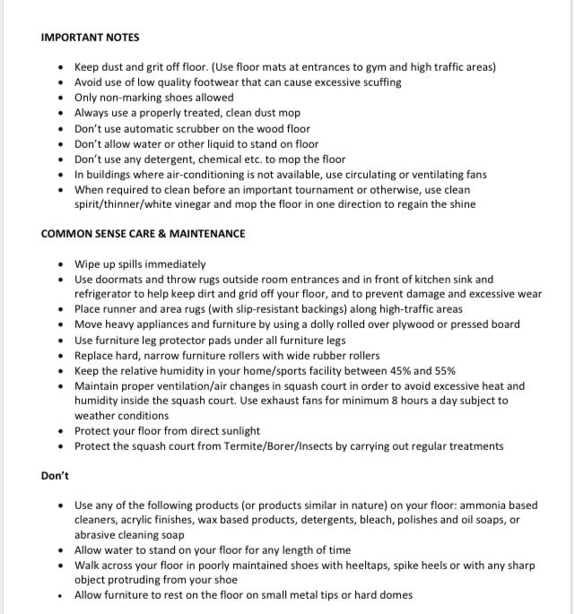
7.Maintenance care manual

